Slide 1
Integrating API into React App 2

Slide 2
Integration Considerations
Review API Design
Develop front end API Module
Endpoints
Routes
React Authentication Context
React Login/Registration Page

Slide 3
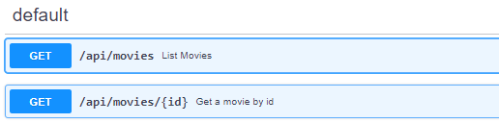
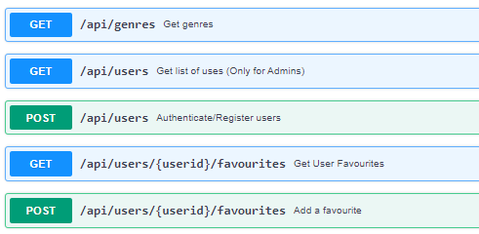
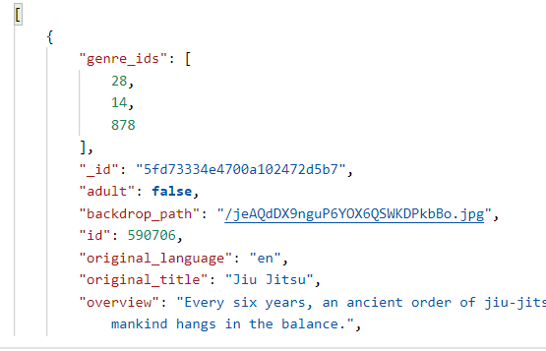
Review API Design
Fully understand the API
Examine Routes
Examine Request & Response Requirements
Body (e.g. properties)
Format (e.g. json)
Examine Authentication
JWT/Sessions
TEST WITH POSTMAN
Even better, write unit tests!

Slide 4
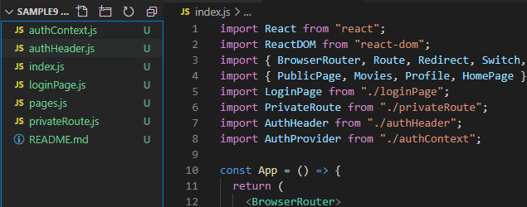
Design React App
This can be your Movies App from assignment 1
Use TMDB up to now
Can update to include authentication(login/register) pages and routes

Slide 5
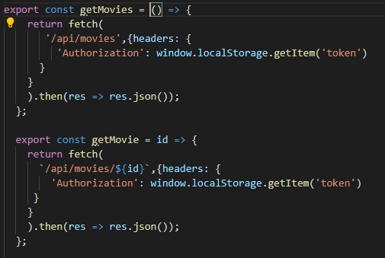
Write/Update API Module
Abstract API calls to exported functions.

Slide 6
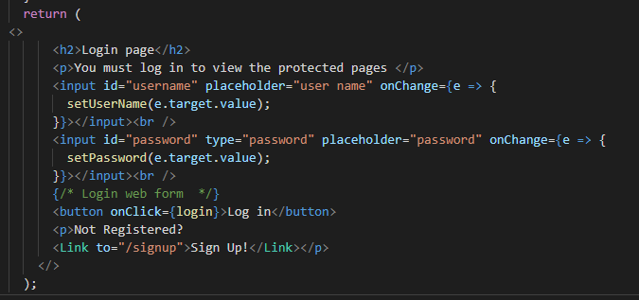
Update pages to use Contexts
Login Page:

Slide 7

Assignment 2

Slide 8
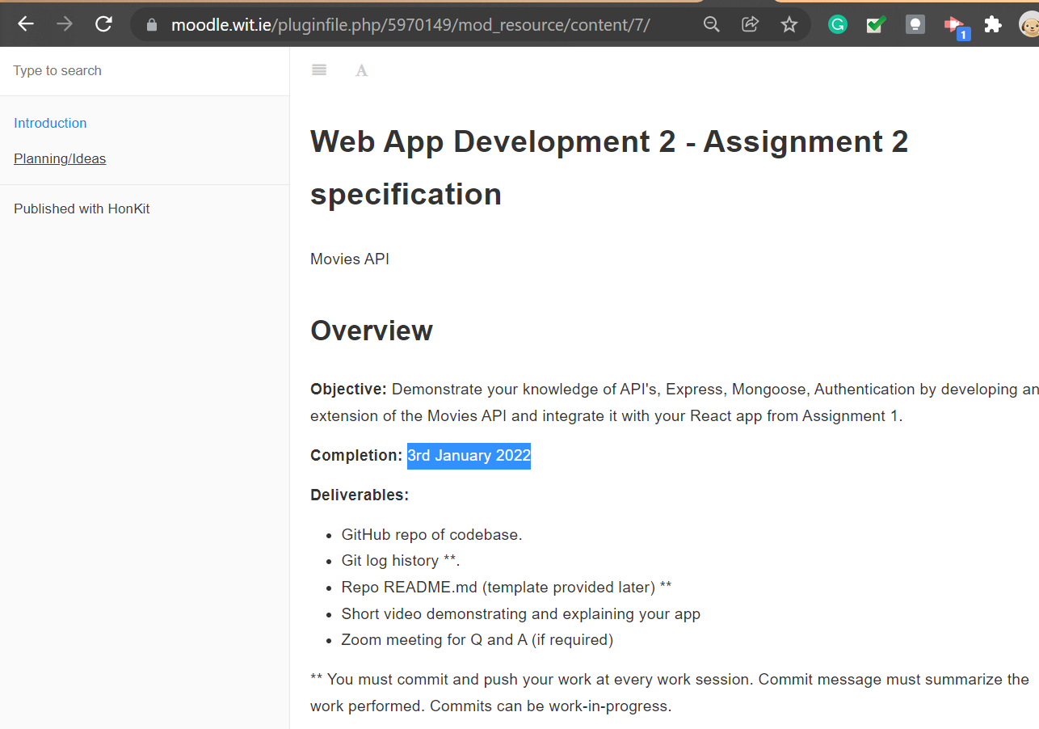
Assignment 2
It’s here: https://moodle.wit.ie/pluginfile.php/5970149/mod_resource/content/7/index.html
40% of your overall mark
Submit on Moodle (Repo)
Due 3rd January.

Slide 9
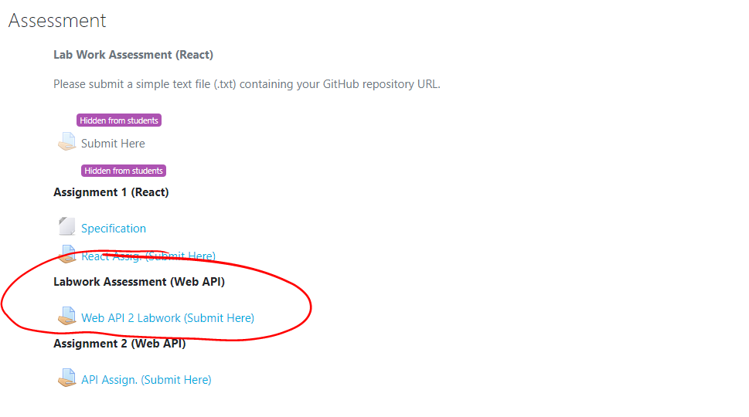
Labwork Assessment
10% of your overall mark
Submit on Moodle by 10th December (or earlier if you’re complete)
Will be looking at commit history.
Submit on Moodle(repo)

Slide 10
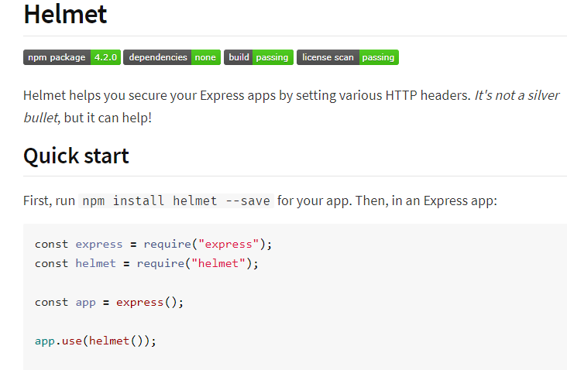
Extra Stuff Examples
Helmet
Better Error Handling
Logging
https://blog.bitsrc.io/23-insanely-useful-nodejs-libraries-you-should-know-in-2020-5a9b570d5416

